Slide 1
Employee Data Analysis using Excel
STUDENT NAME:shakthi .k
REGISTER NO:122204044
DEPARTMENT:B.COM corporate secretaryship
COLLEGE Shri krishnaswamy college for women

Slide 2
PROJECT TITLE
Employee Gender Analysis using Excel

Slide 3


AGENDA
Problem Statement
Project Overview
End Users
Our Solution and Proposition
Dataset Description
Modelling Approach
Results and Discussion
Conclusion
3/21/2024 Annual Review

Slide 4

PROBLEM STATEMENT
Research and Analysis*: Gender data can be used in research studies to identify trends, patterns, and insights that can inform business strategies and contribute to broader social and economic discussions.
Investor and Stakeholder Interest*: Companies may share gender data with investors, stakeholders, or the public to demonstrate their commitment to diversity, equity, and inclusion.

Slide 5

PROJECT OVERVIEW
When it comes to building a inclusive and diverse workplace, understanding the gender dynamics within an organization is crucial. Identifying gender in companies involves collecting and analyzing data on the gender demographics of employees, which can reveal valuable insights into the state of diversity, equity, and inclusion. By examining gender ratios across various roles, levels, and departments, companies can identify areas of strength and weakness, track progress over time, and make data-driven decisions to promote gender equality and create a more balanced and inclusive work environment.As we explore the importance of identifying gender in companies, we'll delve into the benefits, challenges, and best practices associated with this process, and examine how companies can leverage gender data to drive positive change and create a workplace where everyone thrives."

Slide 6

WHO ARE THE END USERS?
end users of gender identification in a company can be:
*HR Departments*: To track diversity metrics, identify areas for improvement, and develop targeted initiatives.
*Diversity, Equity, and Inclusion (DEI) Teams*: To monitor progress, measure the effectiveness of programs, and inform strategic decisions.
*Senior Management*: To understand gender dynamics, make informed decisions, and drive organizational change.
*Department Heads*: To manage team composition, allocate resources, and foster inclusive environments.
*Researchers and Analysts*: To study gender trends, identify patterns, and conduct studies on diversity and inclusion.

Slide 7

OUR SOLUTION AND ITS VALUE PROPOSITION
Pivot_ table
Filter_remove

Slide 8
Dataset Description
Employees =Kaggle
9 Feature
Employees I’d
Name= Text
Employees type
Performance level
Gender - male, Female
Employees rating - numerical

Slide 9

THE "WOW" IN OUR SOLUTION
1.Create a PivotTable*: Select your data range and create a PivotTable to summarize and analyze your data.
2. *Apply filters*: Use the PivotTable filters to narrow down your data to a specific subset
.3. *Remove filters*: Use the Filter_remove function to remove specific filters and make the PivotTable more dynamic.
3/21/2024 Annual Review
9

Slide 10
MODELLING
Data collection
1.*Data Ingestion*: Gathering data from various sources, such as databases, APIs, files, or user input.
2. *Data Storage*: Storing the collected data in a temporary location, like a data lake or a staging area.
3. *Data Scheduling*: Scheduling the data collection process to run at regular intervals
Feature collection
1._Diversity and Inclusion Metrics_ - Track and analyze gender diversity metrics for informed decision-making
2.Compliance and Reporting_ - Ensure accurate gender identification for regulatory compliance and reporting
Data cleaning
*Handle missing values*: - Decide on a strategy to handle missing gender data (e.g., imputation, removal, or replacement with a neutral value)
2. *Standardize gender codes*: - Ensure consistency in gender coding (e.g., M/F, Male/Female, 0/1)
10

Slide 11
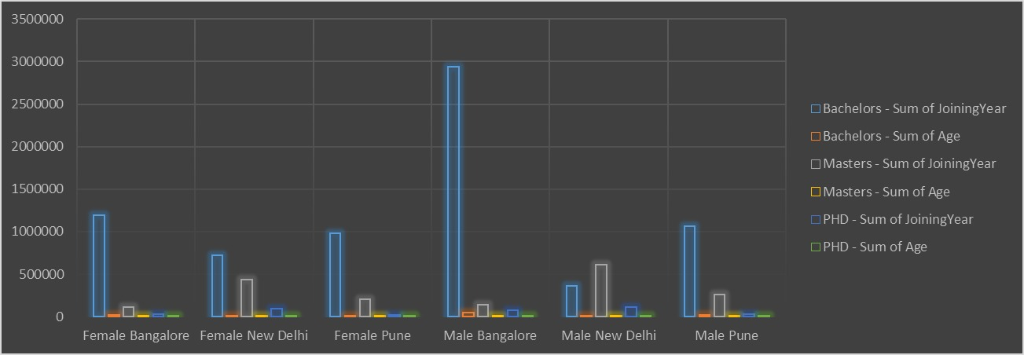
RESULTS
11

Slide 12
conclusion
In conclusion, identifying gender in companies is a crucial step towards building a more inclusive, diverse, and equitable workplace. By collecting and analyzing gender data, organizations can gain valuable insights into their gender demographics, identify areas for improvement, and develop targeted initiatives to promote gender equality. This, in turn, can lead to increased employee engagement, better decision-making, and improved business outcomes.Moreover, identifying gender in companies is not only a moral imperative but also a business imperative. It helps companies to:- Attract and retain top talent- Enhance their reputation and brand- Improve their competitiveness- Drive innovation and creativity- Comply with regulations and laws

